Slide 1
Recommendation system Based on Similarities Between Venues
Musa şahin – IBM data science course capstone project

Slide 2
Introduction/Business Problem
People want to see similar cities when they move.
Real estate companies can recommend similar places to their customers.

Slide 3
Data
Data includes frequency of each venue for the neighborhood. One for Manhattan and one for Toronto
Foursquare API parameters:
Radius: 500 meters
Limit: 30 venues
Location: Neighborhood location

Slide 4
Data Preprocessing
Toronto and Manhattan data frames do not have same venue categories.
135 mutual venues must be considered, different ones are dropped from data frames.

Slide 5
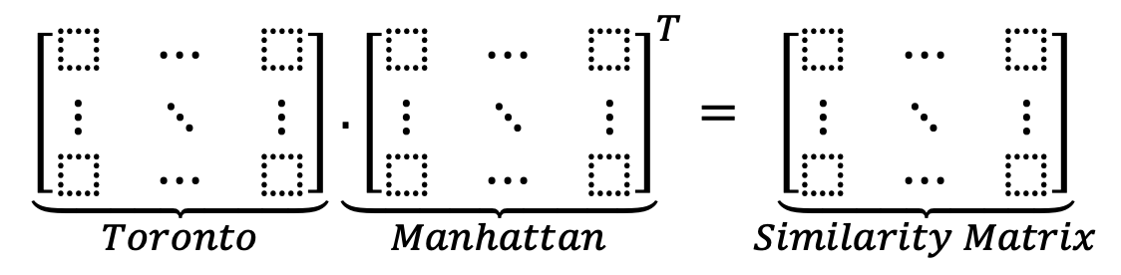
Method
Similarity score = sum of products of same venue category frequencies
Similarity matrix consist of similarity scores.

Slide 6
Result Matrix
For example, similarity score between Christie and Central Harlem is 0.010417

Slide 7
Result evaluation
First three recommendation pair: 'Stuyvesant Town' - 'Rosedale’, 'Battery Park City' - 'Rosedale' and 'Stuyvesant Town' - 'Moore Park, Summerhill East’. All neighborhoods have parks substantially.
Coffee shops are most frequent venue in the Central Bay Street. Recommendations for this neighborhood: Hamilton Heights, Carnegie Hill, Morningside Heights and Murray Hill. They have many coffee shops as well.
Recommendations are generally successful.

Slide 8
Discussion
Lack of variety of venues prevents to make recommendations. For example, Roselawn has all zeros for every similarity scores.
In addition to venue similarity, real estate companies must also consider other parameters to recommend a place for their customers.
For better recommendations a new metric can be created rather than similarity score which can utilize dissimilar places.

